Slide 1
An introduction to Molecular orbitals
By Frank Wensink
2022 June 20th

Slide 2
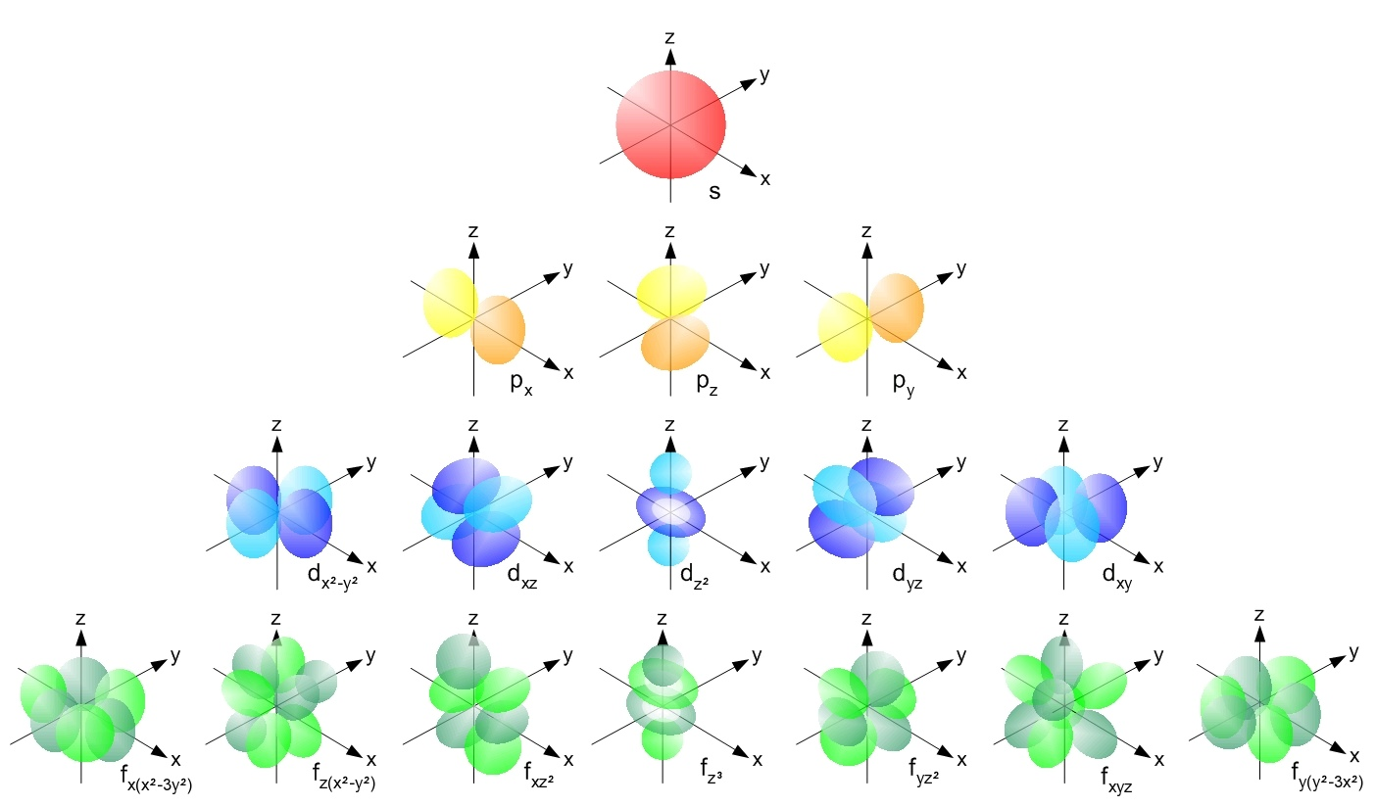
What are Molecular Orbitals?
Atomic Orbitals (AO’s)
Molecular Orbitals (MO’s)
Well…… Mix the AO’s and good luck…
Wikipedia File:Single electron orbitals.jpg

Slide 3
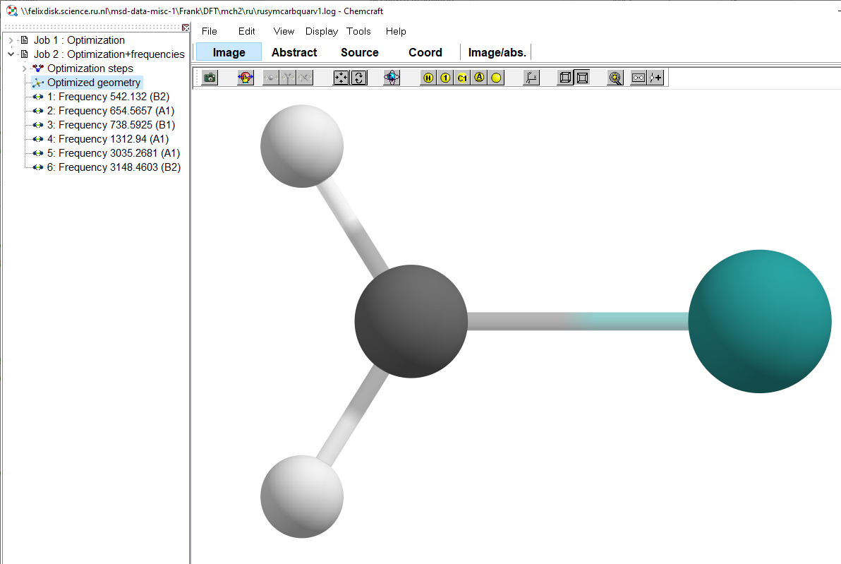
Molecule. Great. What’s next?
This presentation assumes the use of Gaussian for your computations and Chemcraft for visualization.
How to obtain the MO’s?
Go back to the place where you run DFT calculations (and where your .chk file is)
Formchk blabla.chk
You obtained a .fchk file
Open this .fchk file in Chemcraft

Slide 4
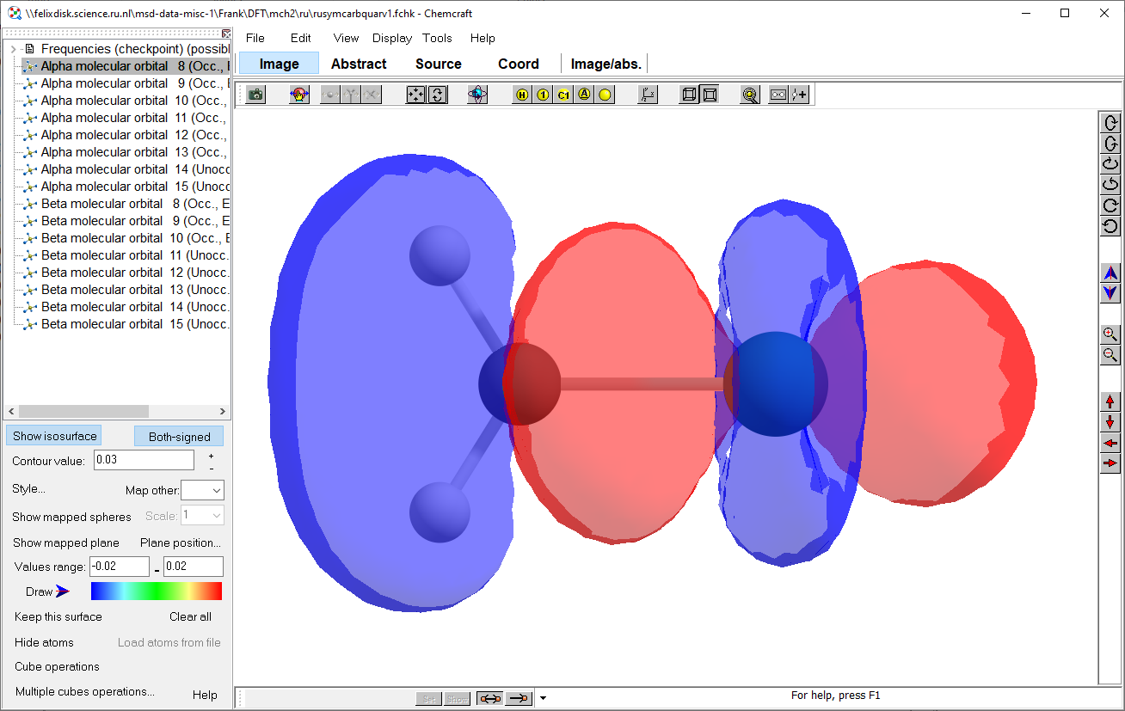
The .fchk file
Open the .fchk file in Chemcraft
Press Tools > Orbitals > render molecular orbitals
Select the alpha AND beta orbitals you are interested in

Slide 5
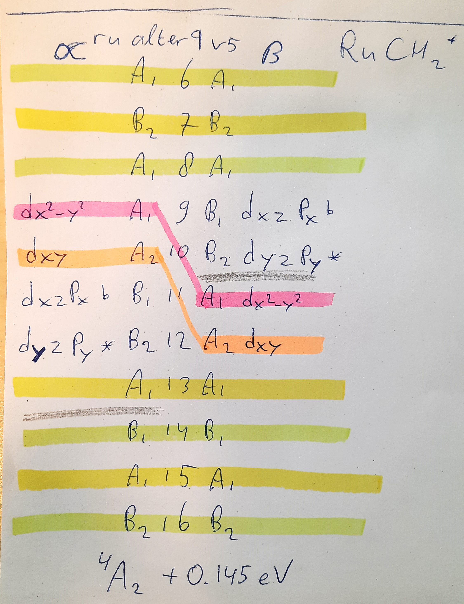
Identify the MO’s
Compare alpha and beta: are they similar?
Identify the remaining orbitals:
Symmetry
Orientation
Bonding character

Slide 6
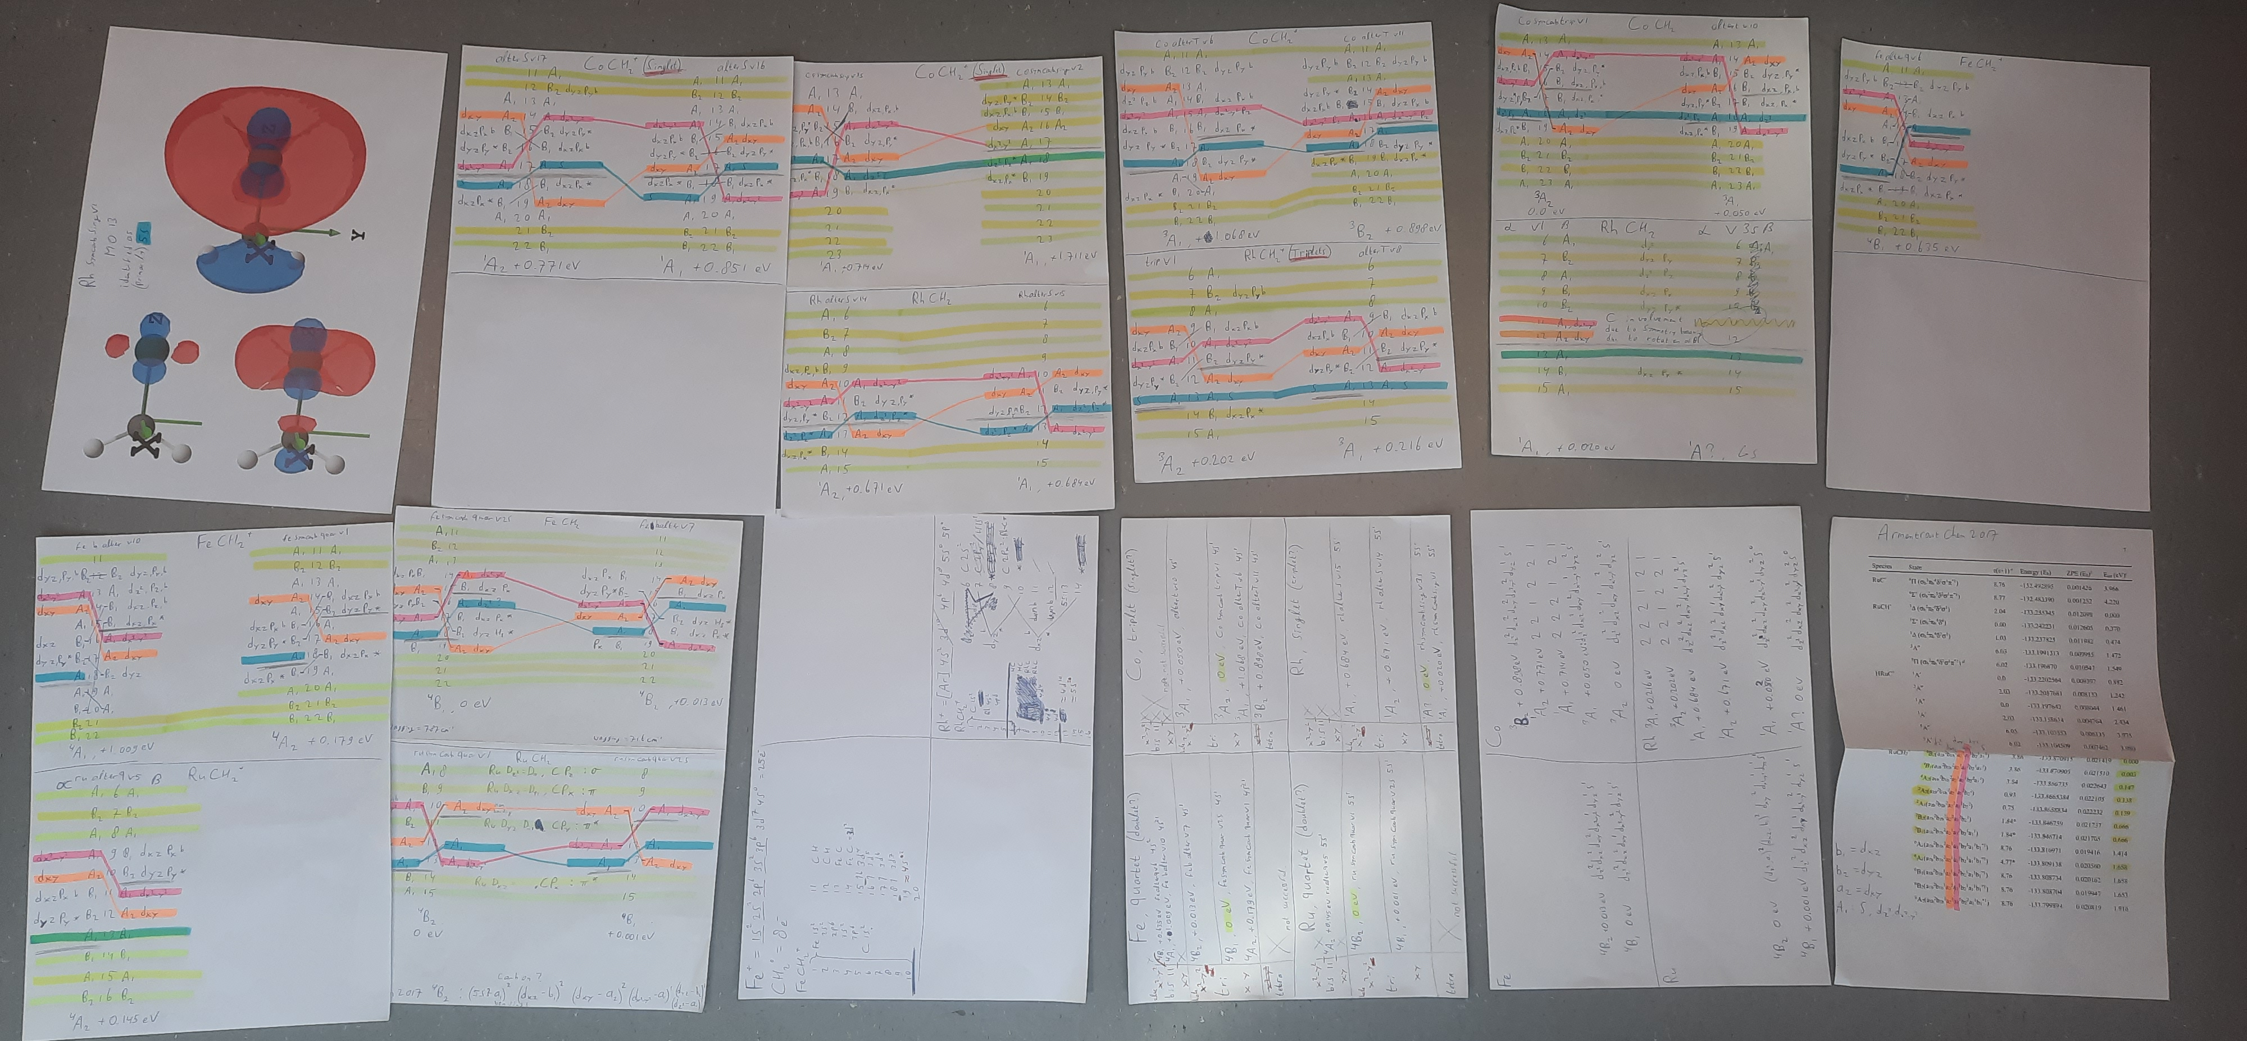
Have some fun

Slide 7
Draw conclusions
FeCH₂⁺, RuCH₂⁺ and CoCH₂⁺ are very similar:
Fe ground states (GSs):
  d_{z2}:d_{xz}:d_{xy}:d_{x2-y2}:d_{yz}:s
  2:2:1:2:1:1 & 2:2:2:1:1:1
Ru GSs:
  2:2:1:2:1:1 & 2:2:2:1:1:1
Co GSs:
  2:2:1:2:2:1 & 2:2:2:1:2:1
RhCH₂⁺ is different:
  2:2:2:2:2:0
Filled d_{xy} and d_{x2-y2} orbitals
No s orbital occupation

Slide 8
Excited states: guess(alter)
--Link1--
#p ub3lyp Chkbasis Guess(Read,alter) Geom=Check pop=full GFInput opt=calcall iop(7/33=1)
ghjghjghj
1 4
14 14
9 11
The keywords guess=alter allows you to swap the molecular orbitals (in other words: change the MOs electron occupation)
In the example on the left:
Alpha MO 14 is swapped with beta MO 14
  (This is no change but ensures correct reading of the input file by Gaussian)
Beta MO 9 is swapped with beta MO 11

Slide 9
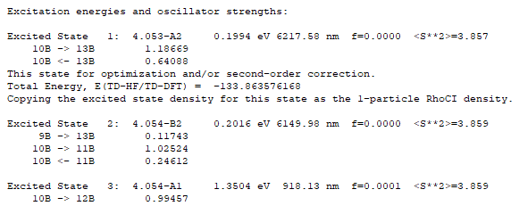
Excited states: TD (time dependent)
Searching for higher energy electronic states should be made easier by using time-dependent DFT calculations.

